Slide 1

Your Company Name
Clean Investor Deck
SIMPLICITY IS THE ULTIMATE SOPHISTICATION
MSOE Hackthsgiving 2025

Slide 2



The Team
Team Member
Team Member
Introduce the key members of your team. It's people investors often invest in.
Introduce the key members of your team. It's people investors often invest in.
Team Member
Introduce the key members of your team. It's people investors often invest in.
MSOE Hackthsgiving 2025

Slide 3

Table of Contents
Executive Summary
02
Problem & Solution
03
Your Product / Service
05
Competitive Advantages
06
Competitive Analysis
07
Team
08
Target Market Opportunity
09
Business Model
10
Traction & Milestones
11
Marketing, Sales, and Finances
12
Investment & Use of Funds
14
MSOE Hackthsgiving 2025

Slide 4

Executive Summary
Your Vision and Value Proposition
A short overview of your business and the value that you provide to your potential customers. Keep it simple and clear.
MSOE Hackthsgiving 2025

Slide 5

The Problem
Problem 1
Introduce the problem to solve--make sure your audience can relate. Present it in a way that makes old solutions sound obsolete.
Define the problem you are trying to solve and who has is. What pain points are you trying to address? Why do you get out of bed in the morning?
Problem 2
Introduce the problem to solve--make sure your audience can relate. Present it in a way that makes old solutions sound obsolete.
Problem 3
Introduce the problem to solve--make sure your audience can relate. Present it in a way that makes old solutions sound obsolete.
MSOE Hackthsgiving 2025

Slide 6

The Solution
List 3 ways your company proposes to solve the problem. Adopt your customer's point of view when doing so. Use empathy.
Solution 1
Solution 2
Solution 3
Present one of your solutions if multiple; or a first step, feature, or pre-requisite if not.
Present one of your solutions if multiple; or a first step, feature, or pre-requisite if not.
Present one of your solutions if multiple; or a first step, feature, or pre-requisite if not.
MSOE Hackthsgiving 2025

Slide 7


Your Product or Service
Quick summary of what your product or service can do for your audience
Introduce the details of your product or service and how it'll help prospects solve their problem. Keep it high-level and easy to understand. Think elevator pitch.
MSOE Hackthsgiving 2025

Slide 8



Competitive Advantages
Benefit 1
Benefit 2
Benefit 3
What makes your product or service special and different?
Make sure you are addressing your audience's problems.
Don't get technical--these should be high-level enough.
MSOE Hackthsgiving 2025

Slide 9




Competitive Analysis
Competitor 2
Why is your solution better than competitor's #2?
Define your main competitors and their alternative solutions to the problem you are planning to solve.
Competitor 1
Competitor 3
Why is your solution better than competitor's #1?
Why is your solution better than competitor's #3?
MSOE Hackthsgiving 2025

Slide 10
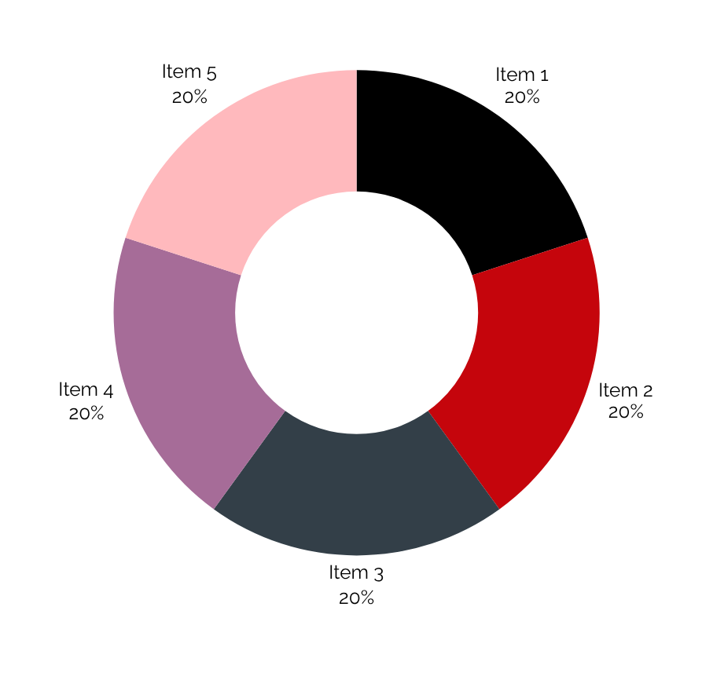
Target Market Opportunity
How big is the market your company is after?
Define your potential customers and the total size of your target market.
MSOE Hackthsgiving 2025

Slide 11
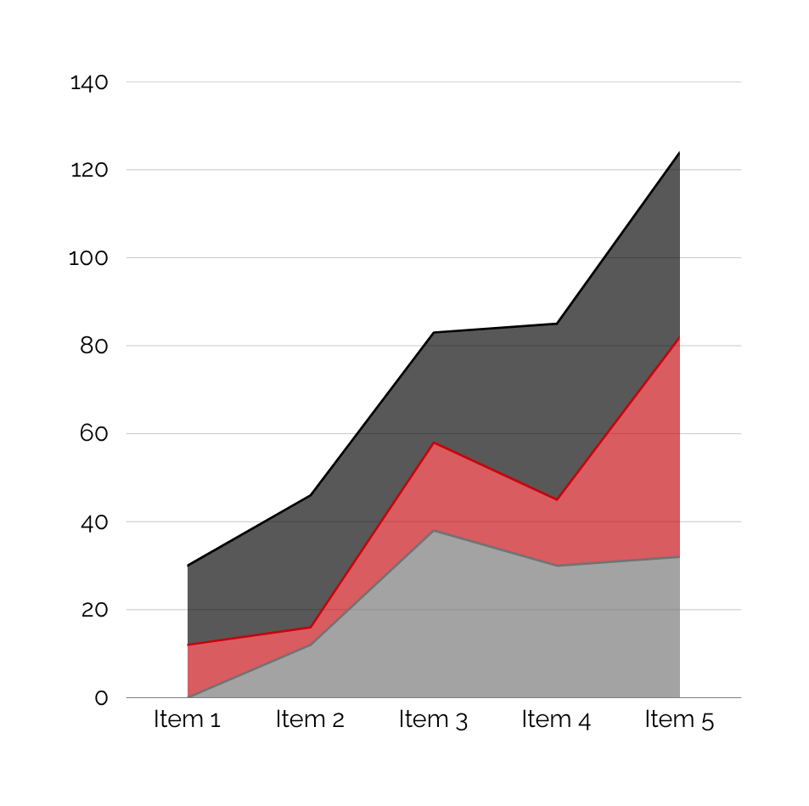
Target Market Opportunity
How big is the market your company is after?
Define your potential customers and the total size of your target market.
MSOE Hackthsgiving 2025

Slide 12

Business Model & Revenue Streams
Revenue Stream 1
Revenue Stream 2
Revenue Stream 3
Describe how your product or service makes money, and what the expected revenues are.
Describe how your product or service makes money, and what the expected revenues are.
Describe how your product or service makes money, and what the expected revenues are.
10
MSOE Hackthsgiving 2025

Slide 13

Traction/Milestones
Boost your business model by providing a proof of validation that your solution really works to solve the problem you have identified.
Milestone 1
Milestone 3
Milestone 5
Explain an event worth mentioning for your company.
Explain an event worth mentioning for your company.
Explain an event worth mentioning for your company.
Milestone 2
Milestone 4
Explain an event worth mentioning for your company.
Explain an event worth mentioning for your company.
MSOE Hackthsgiving 2025

Slide 14

Marketing & Sales Plan
Marketing Strategy
Sales Strategy
What is your marketing and sales plan? How you are planning to promote your product or service to prospective customers.
What is your marketing and sales plan? How you are planning to promote your product or service to prospective customers.
MSOE Hackthsgiving 2025

Slide 15
Use 1
Investors like to see that you have a plan. Explain how you expect to deploy the funds you are raising.
The Investment / Use of Funds
Use 2
Investors like to see that you have a plan. Explain how you expect to deploy the funds you are raising.
Finally, ask for the money. How much money are you seeking, and how are you planning to use it to achieve your business goals.
Use 3
Investors like to see that you have a plan. Explain how you expect to deploy the funds you are raising.
14

Slide 16
Thank You
Contact Information
www.reallygreatsite.com
hello@reallygreatsite.com
+123-456-7890
MSOE Hackthsgiving 2025

